Slide 1
Monopoly Market

Slide 2
Topics to be covered
Structure of the Monopoly Market
Short-run Price and Output determination
Long-run Price and Output determination
Social Cost of Monopoly Market
Price Discrimination in Monopoly
Resources that can be consulted:
H. C. Petersen, W. C. Lewis and S. K. Jain, Managerial Economics, 4th ed., Pearson Education 2006.
D. Salvatore, Managerial Economics in a Global Economy, 8th ed., Thomson Asia, 2015.
Varian, Hal R. Intermediate Microeconomics: A Modern Approach (7 th ed.). New York: W.W. Norton & Co, 2010.
Keat, P., Young, P., & Erfle, S.,Managerial economics: Economic tools for today’s decision makers (7 th ed.) Upper Saddle River, NJ: Prentice Hall, 2014
2

Slide 3
Monopoly Market
Monopoly is the polar opposite of perfect competition
Pure Monopoly: Industry is the firm!
3

Slide 4
Monopoly Market
Structure:
Many buyers and single seller.
Buyers are price takers and seller is the price maker
No close substitutes for product
Significant barriers to entry
Ownership of a unique resource (Diamonds)
Government granted rights for exclusive production (e.g. patents, copyrights, licenses, concessions)
Economies of scale and declining long-run average costs
4

Slide 5
Implications
Monopolist faces the entire market demand curve.
Profits can persist in the short and long-run.
Possibility of price discrimination
Prices in excess of MC
Consumer choice limited
5

Slide 6
Demand Curves
A Competitive Firm’s
Demand Curve
A Monopolist
's Demand Curve
Price
Price
Demand
Demand
0
Quantity of Output
0
Quantity of Output
6
Copyright © 2004 South-Western
Notes:
6

Slide 7
Demand and MR curves
Price
$11
10
9
8
7
6
5
4
3
Demand
2
Marginal
(average
1
revenue
revenue)
0
–1
1
2
3
4
5
6
7
8
Quantity of Water
–2
–3
–4
7
Copyright © 2004 South-Western
Notes:
7

Slide 8
Price Determination
As in perfect competition, profit for the monopolist is maximized at a point where MC = MR.
What is different for a monopolist ?
marginal revenue does not equal price; marginal revenue is below price.
8

Slide 9
Price Determination-short run¹
Costs and
Revenue
. . and then the demand
The intersection of the
curve shows the price
marginal-revenue curve
consistent with this quantity.
and the marginal-cost
curve determines the
B
profit-maximizing
Monopoly
quantity . . .
price
Average total cost
A
Marginal
Demand
cost
Marginal revenue
0
Q
Q_{MAX}
Q
Quantity
9
Copyright © 2004 South-Western
Notes:
9

Slide 10
Monopolist’s Profit-short run²
Costs and
Revenue
Marginal cost
Monopoly
E
B
price
Monopoly
Average total cost
profit
Average
total
D
C
cost
Demand
Marginal revenue
0
Q_{MAX}
Quantity
10
Copyright © 2004 South-Western
Notes:
10

Slide 11
Vidyut Vitran Nigam is the sole supplier of electricity in a city. The demand and Marginal costs of electricity are given by-
P= 200-4Q MC=4Q
What is the profit maximising price and quantity?
11
11

Slide 12
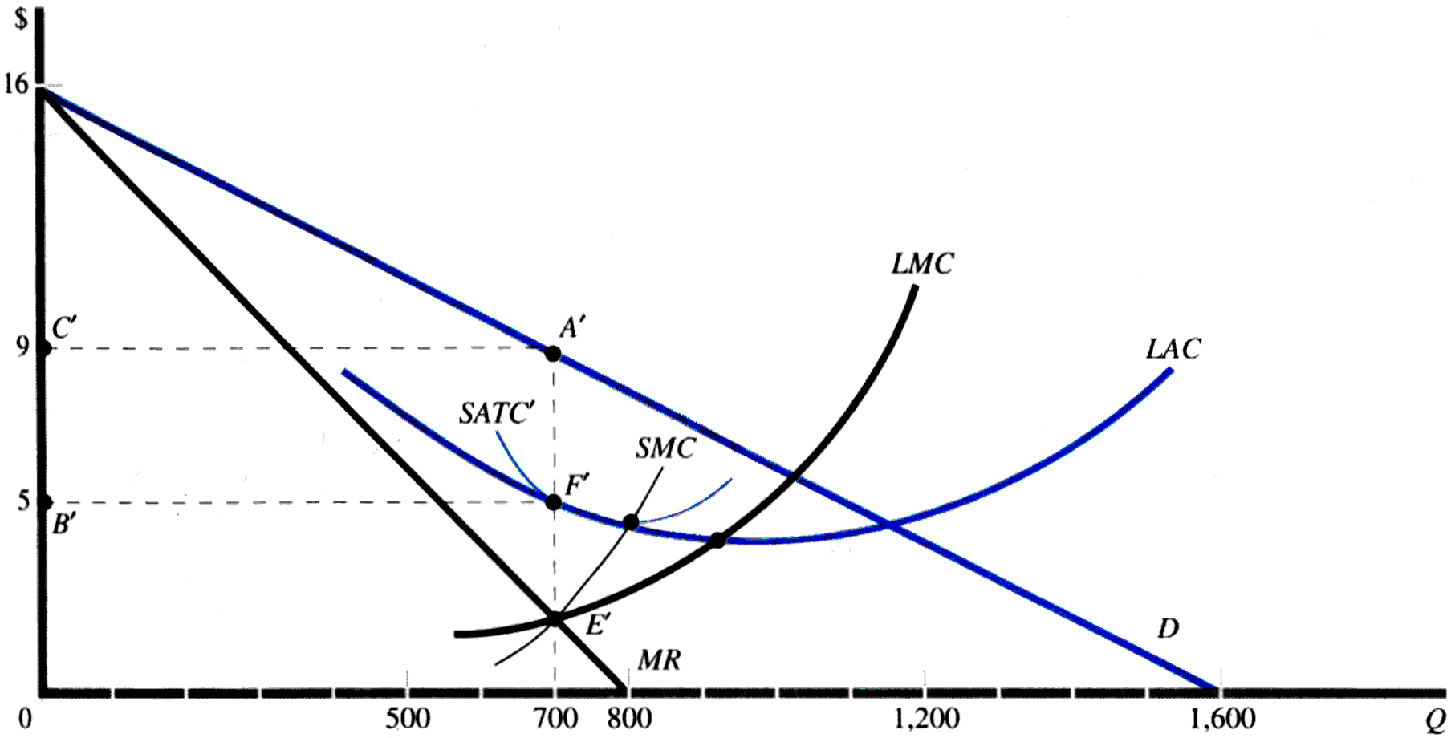
Monopolist’s Profit-long run³
12

Slide 13
Social Cost of Monopoly
In competitive markets, firms produce where
P=MC
And since
P=MR=willingness to buy
And
MC=willingness to sell
P=MC → MR=MC or
Maximum total surplus
13

Slide 14
Inefficiency of monopoly in comparison to perfect competition market⁴
Price
Consumer
surplus
Monopoly
Deadweight
price
loss
Profit
Marginal cost
Marginal
Demand
revenue
0
Quantity sold
Quantity
14
Copyright © 2004 South-Western
Notes:
14

Slide 15
Price discriminating Monopolist
Price discrimination is the ability to charge different prices to different customers.
Automobiles are seldom sold at their sticker price.
Theaters have midweek special rates.
Restaurants generally make most of their profit on alcoholic drinks and just break even on food.
College-town stores often give students discounts.
Movie theaters give senior citizens and child discounts.
15

Slide 16
The demand of a monopolist is given by
P= 50-2Q and marginal cost is Rs 10.
Compute the dead weight loss associated with monopoly pricing.
16

Slide 17
Practice Questions:
1.Monopoly is a market structure characterised by all the following features except
A. The firm is a dominant seller of a good or service having no close substitutes
B. The existence of high barriers to entry
C. The firm enjoys economic profit even in the long run
D. The firm is the price taker
2.A pure monopoly is unlikely to achieve allocative efficiency because
A. equilibrium price is not equal to marginal cost.
B. equilibrium profit is not equal to normal profit.
C. equilibrium cost is rising due to diseconomies of scale.
D. equilibrium output is not at the lowest point of the AC curve.
17

Slide 18
3.If a monopoly takes over 100% of a market previously operating under perfect competition, the long run impact on price and output will be
A. price will be higher and output will be lower.
B. price will be lower and output will be higher.
C. price will be higher and output will be higher.
D. It is not possible to predict without further information about the market
4.The marginal revenue curve for a single-price monopoly
A. lies above its demand curve.
B. is horizontal.
C. lies below its demand curve.
D. coincides with its demand curve.
18

Slide 19
5.Compared to a competitive industry, a monopoly transfers
B. producer surplus to consumers.
consumer surplus to producers.
C. deadweight loss away from producers to consumers.
D. deadweight loss away from consumers to producers.
ANSWERS
1. D 2. A 3. A 4.C 5. B
19

Slide 20
References
1.Varian, Hal R. Intermediate Microeconomics: A Modern Approach (7 th ed.). New York: W.W. Norton & Co, 2010.
2. Varian, Hal R. Intermediate Microeconomics: A Modern Approach (7 th ed.). New York: W.W. Norton & Co, 2010.
3. D. Salvatore, Managerial Economics in a Global Economy, 8th ed., Thomson Asia, 2015.
4. Varian, Hal R. Intermediate Microeconomics: A Modern Approach (7 th ed.). New York: W.W. Norton & Co, 2010
20

